Slide 1
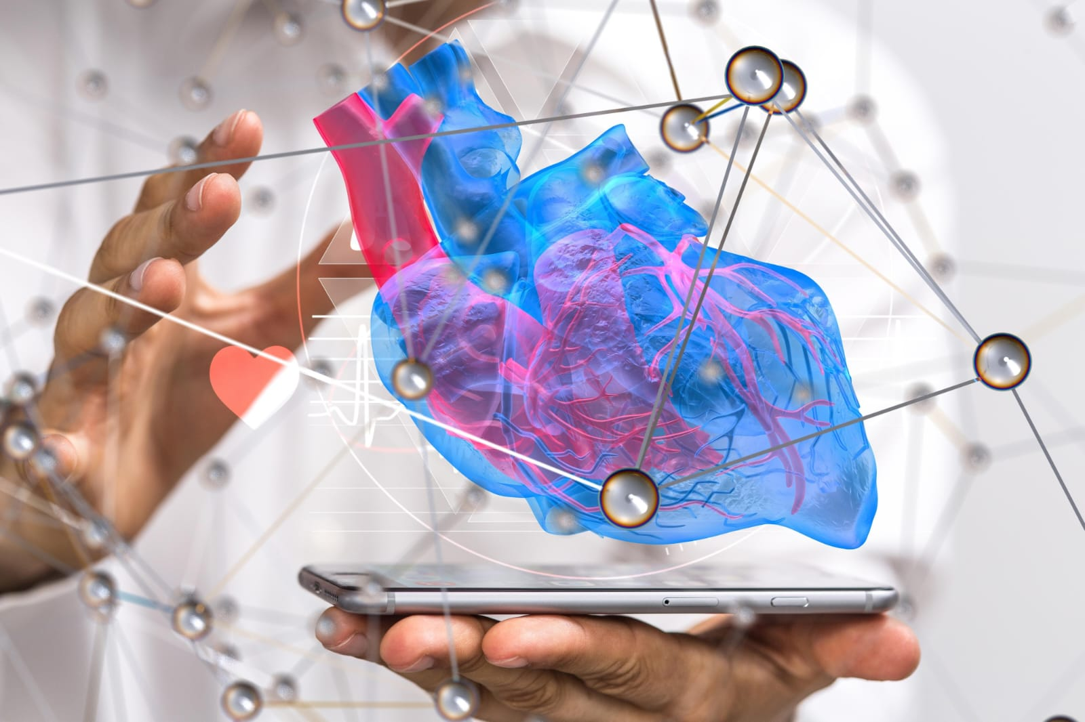
PROJECT TITLE: Enhancing Arrhythmia Diagnosis Through ECG Deep Learning Classification Deploying And Augmented Reality 3D Heart Visualization And Interaction

Slide 2
Enhancing Arrhythmia Diagnosis Through ECG Deep Learning Classification Deploying And Augmented Reality 3D Heart Visualization And Interaction
Under the Guidance of : K. Keerthi Reddy
Done by :
K. Pranathi(22U11A6724)
G. Hyndhavi(22U11A6716)
D. Yakub(22U11A6712)
M. Hari Venu(22U11A6721)

Slide 3
CONTENTS
Abstract
Existing System
Proposed System
Literature Survey
Architecture
Modules
Execution Procedure
Algorithms
UML Diagrams

Slide 4
Abstract
Cardiovascular diseases require accurate and timely diagnosis, but manual ECG analysis is complex and time-consuming.
Proposed system ArythmiAR integrates Deep Learning (CNN, MLP) with Augmented Reality (AR).
Uses MIT-BIH Arrhythmia dataset for training and evaluation.
Achieves ~99.07% accuracy using MLP with data rebalancing techniques.
Provides 3D heart visualization to localize arrhythmia regions.
Enables interactive and efficient diagnosis for improved clinical decision-making.

Slide 5
Existing system
Relies on cardiologists for manual ECG interpretation, making the process time-consuming and dependent on expertise.
Manual analysis is complex and can lead to delays and potential human errors.
Traditional ML models struggle with imbalanced datasets and overfitting issues.
Models often show poor generalization across different patient data.
Provides only 2D ECG signals or numerical outputs without spatial context.
No clear mapping between ECG signals and affected heart regions.

Slide 6
Disadvantages
Time-consuming diagnosis due to manual ECG interpretation by specialists.
High risk of human error and misinterpretation, especially with complex signals.
Traditional ML models suffer from overfitting and poor performance on imbalanced data.
Limited ability to generalize across different patient datasets.
Provides only 2D ECG outputs without spatial understanding of heart regions.
Lack of real-time and interactive visualization for better analysis.

Slide 7
Proposed System
Integrates Deep Learning (CNN, MLP) with Augmented Reality (AR) for accurate arrhythmia detection.
Uses data rebalancing techniques to improve performance on imbalanced ECG datasets.
Provides automated ECG classification, reducing dependency on manual interpretation.
Implements 3D heart modelling to visualize anatomical regions affected by arrhythmia.
AR-based system enables real-time interaction and localization of abnormalities.
Improves diagnostic accuracy, speed, and clinical decision-making.

Slide 8
Benefits
Provides high accuracy (~99%) in arrhythmia detection using deep learning models.
Reduces manual effort and diagnosis time through automated ECG classification.
Handles imbalanced datasets effectively using data rebalancing techniques.
Enables 3D visualization of heart regions for better understanding of abnormalities.
AR-based system allows interactive and real-time analysis of arrhythmia.
Improves clinical decision-making and patient care outcomes.

Slide 9
Literature Survey
Year | Authors | Contribution & Simplified Findings
2025 | Seiichi Morokuma | Uses deep learning to convert BCG signals into ECG signals for heartbeat monitoring. Provides accurate prediction of heart intervals and supports continuous monitoring.
2025 | Ali Raza, Shahid | Applies deep neural networks for biomedical signal classification using advanced feature encoding. Demonstrates high accuracy and effectiveness of deep learning in medical data analysis.
2023 | Z. Zhao, Y. Zhang | Proposes CNN-based model for automatic ECG arrhythmia classification. Achieves high accuracy on MIT-BIH dataset and reduces dependency on manual diagnosis.

Slide 10
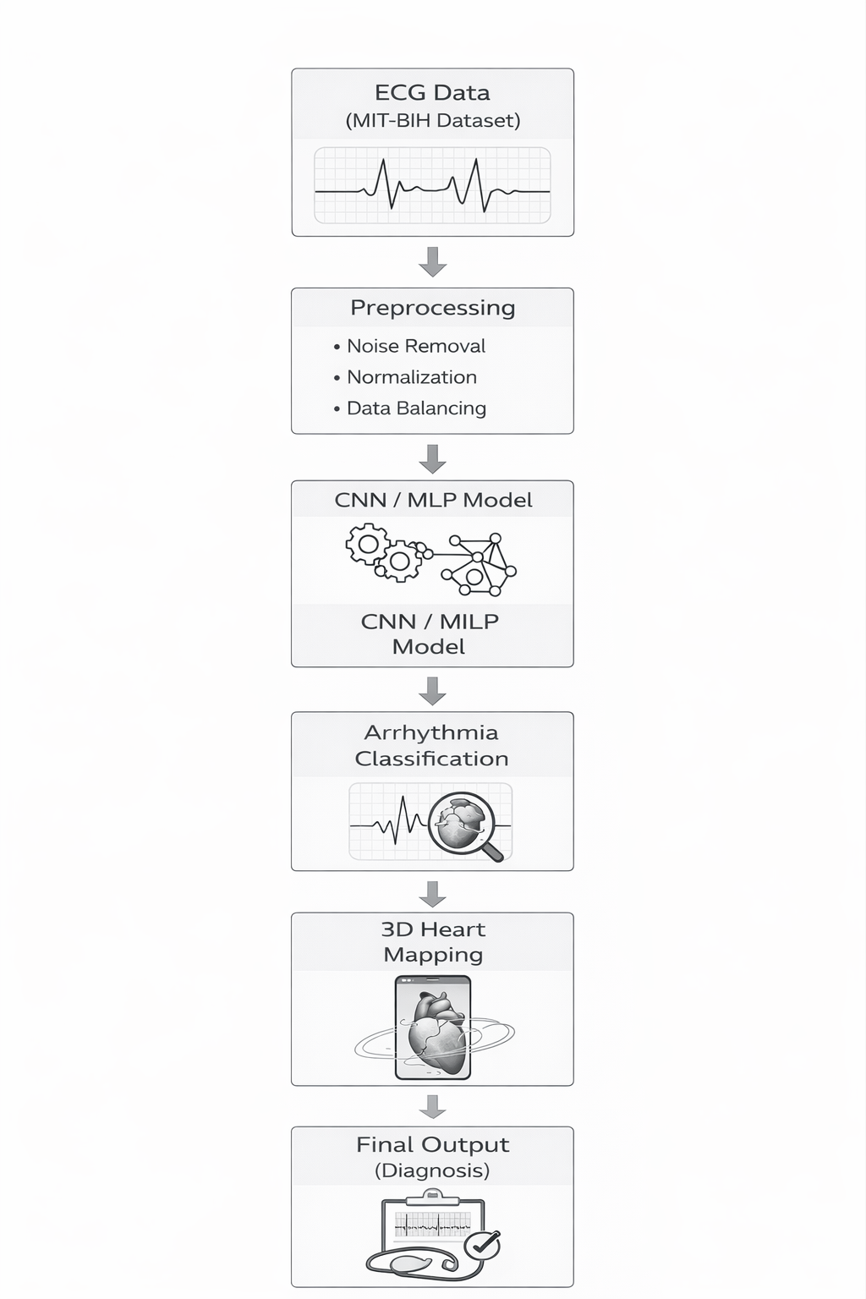
System Architecture

Slide 11
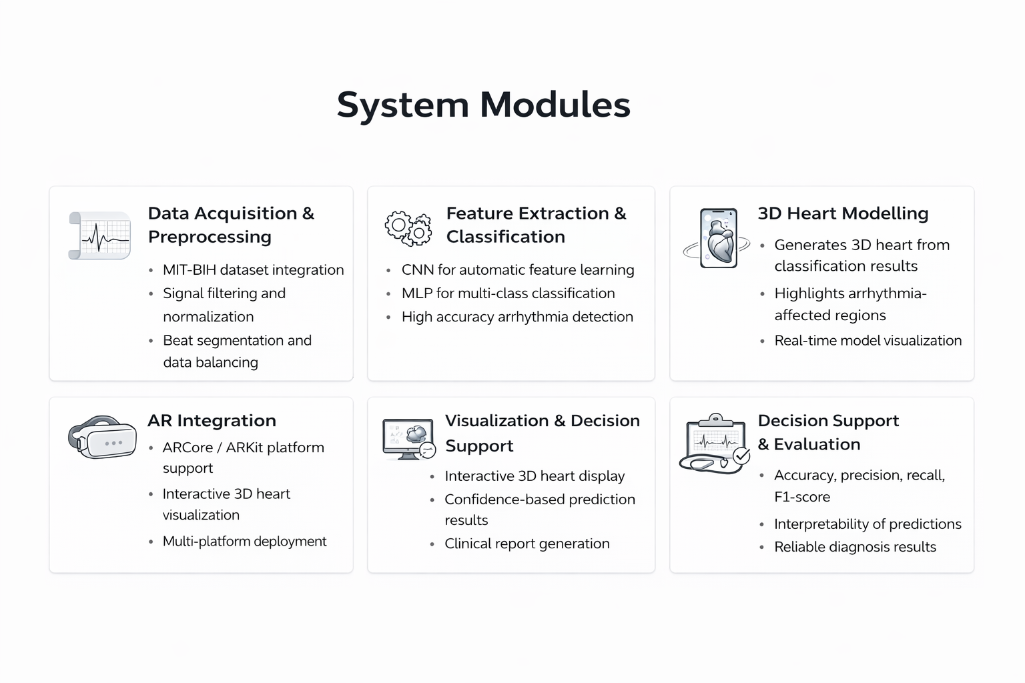

Slide 12
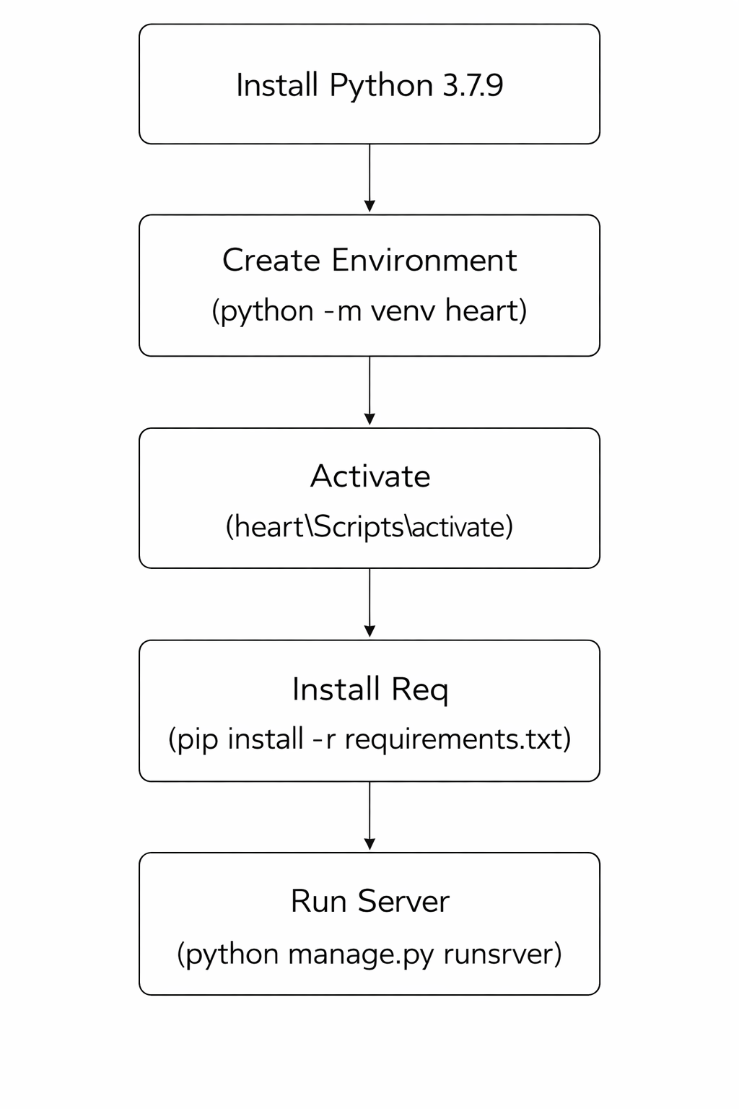
Execution Procedure

Slide 13
Algorithms Used
1. CNN (Convolutional Neural Network)
Processes raw ECG signals directly as input data without requiring manual feature extraction
Uses convolution layers to detect waveform patterns such as P waves, QRS complex, and T waves
Applies pooling layers to reduce noise and dimensionality while retaining important signal features
Learns spatial and temporal features automatically from ECG signal variations
Performs accurate classification of arrhythmia types based on learned signal patterns
Provides robust performance on complex ECG data making it suitable for automated diagnosis

Slide 14
2. MLP (Multilayer Perceptron)
Uses extracted ECG features such as R-R interval and QRS duration as input for arrhythmia classification
Processes data through multiple fully connected layers to transform input features into meaningful representations
Learns complex relationships between ECG features using hidden layers and activation functions
Performs multi-class classification of arrhythmia types based on learned feature patterns
Provides faster computation compared to CNN models making it efficient for real-time prediction
Achieved highest accuracy (~99.07%) on MIT-BIH dataset demonstrating strong performance in this project

Slide 15
3. Data Rebalancing Techniques
Addresses imbalance where normal ECG beats dominate and rare arrhythmia classes are underrepresented
Uses SMOTE to generate synthetic minority samples improving diversity without duplication
Applies undersampling to reduce majority class samples creating a more balanced dataset
Uses class weights to give higher importance to rare classes during model training
Improves detection of minority arrhythmias and enhances overall model performance

Slide 16
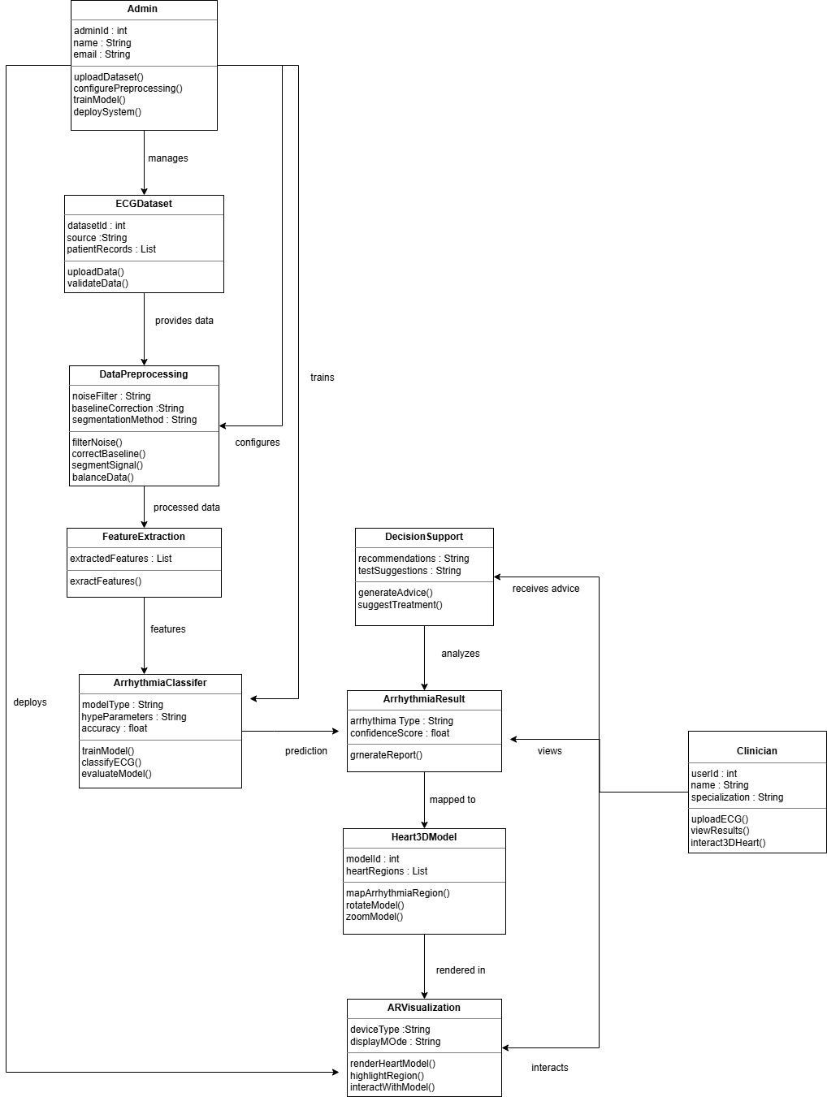
UML diagrams
1. Class Diagram

Slide 17
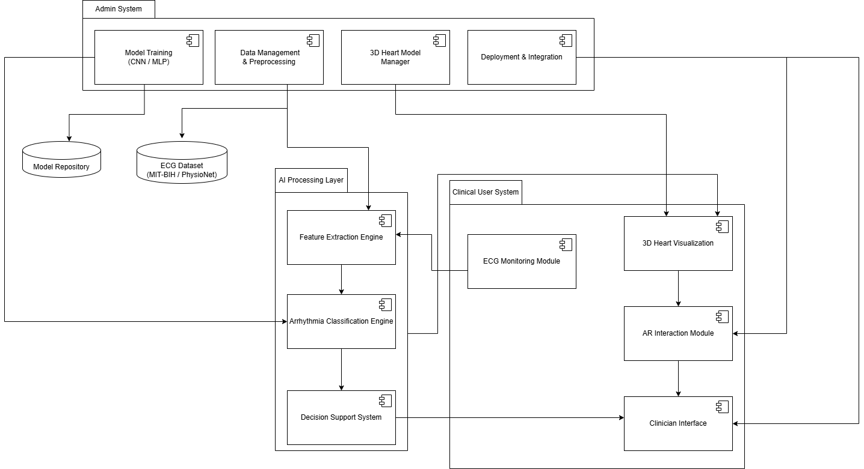
2. Component Diagram

Slide 18
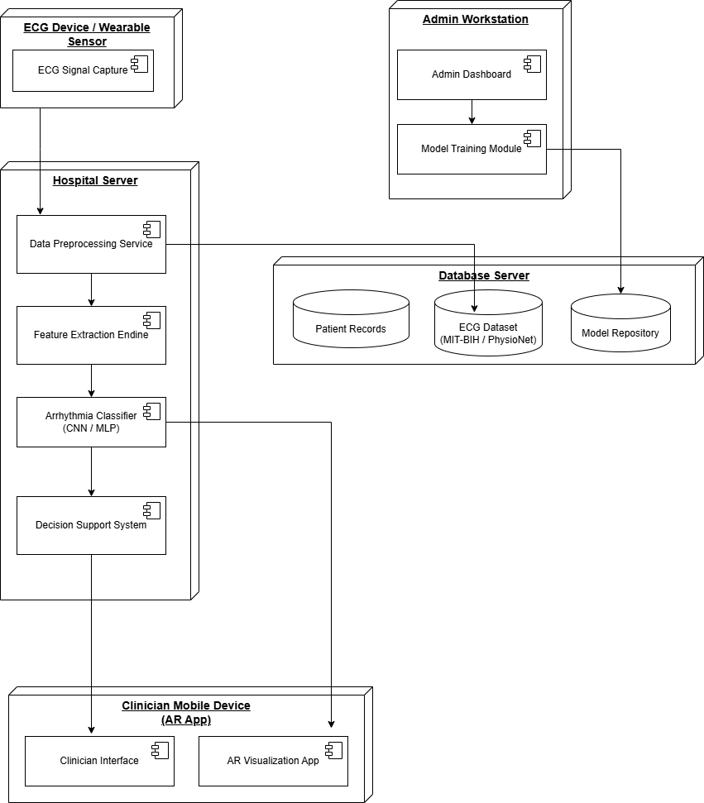
3. Deployment Diagram

Slide 19
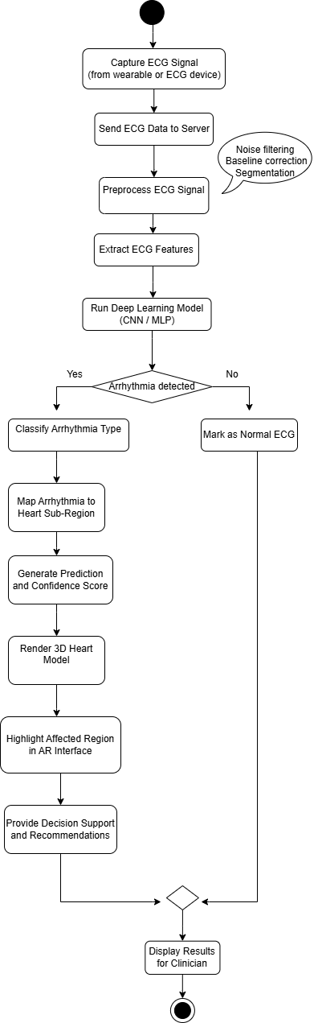
4. Activity Diagram

Slide 20
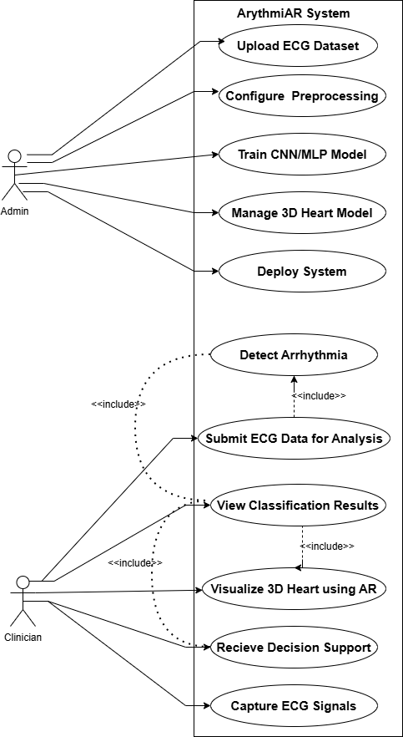
5. Use Case Diagram

Slide 21
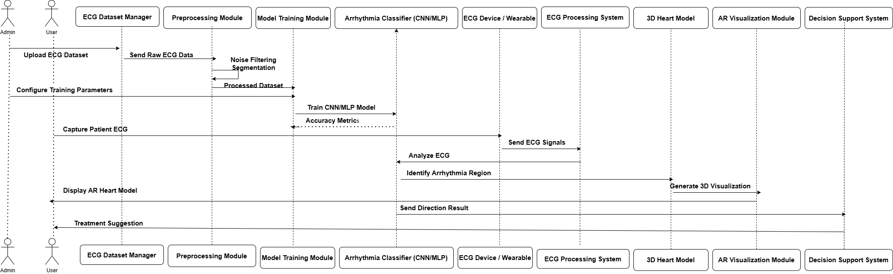
6. Sequence Diagram

Slide 22
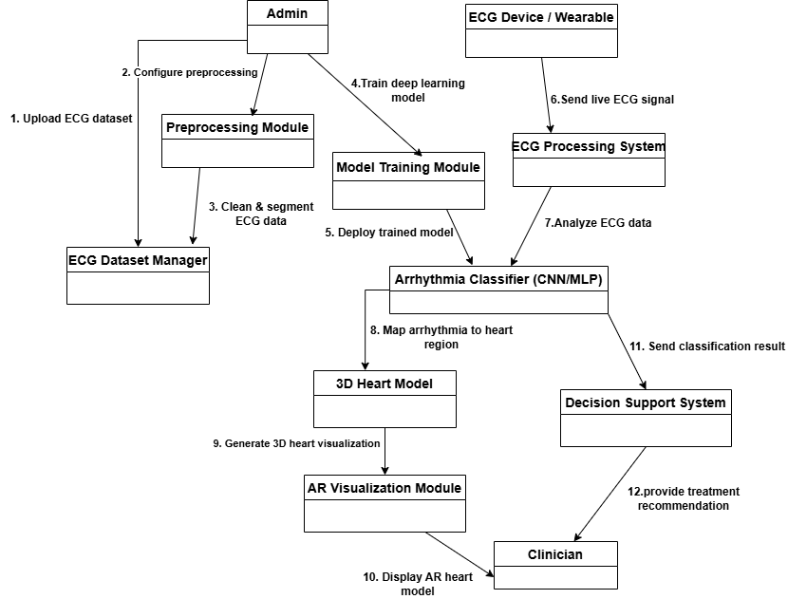
7. Collabration Diagram

Slide 23
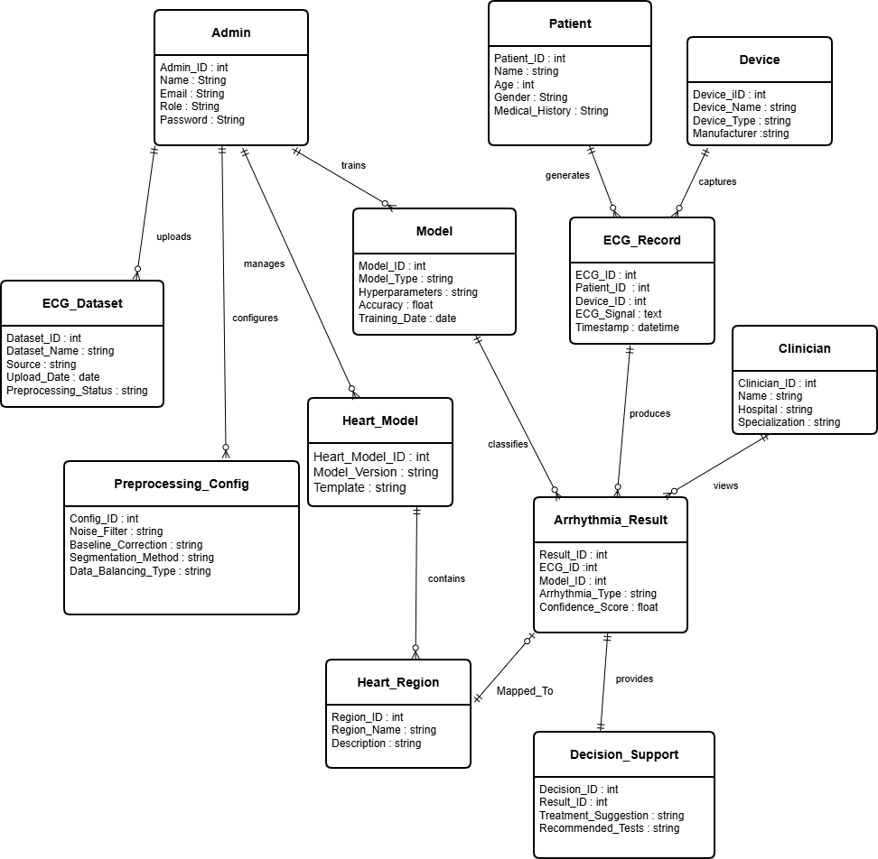
8. E-R Diagram

Slide 24
Conclusion
The proposed system successfully integrates Deep Learning (CNN, MLP) with Augmented Reality for arrhythmia diagnosis
Provides high accuracy (~99%) in ECG classification improving reliability compared to traditional methods
Reduces manual effort and diagnosis time through automated ECG signal analysis
Enables 3D visualization of heart regions helping in better understanding of abnormalities
AR-based interaction allows real-time exploration of heart model improving clinical decision-making
Overall, the system enhances accuracy, efficiency, and visualization making it useful for medical and educational applications

Slide 25
Thank you!

